Slide 1



Slide 2


Slide 3

The following two letters are intended to serve as a starting point for communications to be shared prior to the start of on-campus instruction in order to inform a) families and b) staff of the procedures your system will have in place to reduce the risk of COVID-19 spread on campus. These templates can be adapted to meet the needs of your school system.

Slide 4
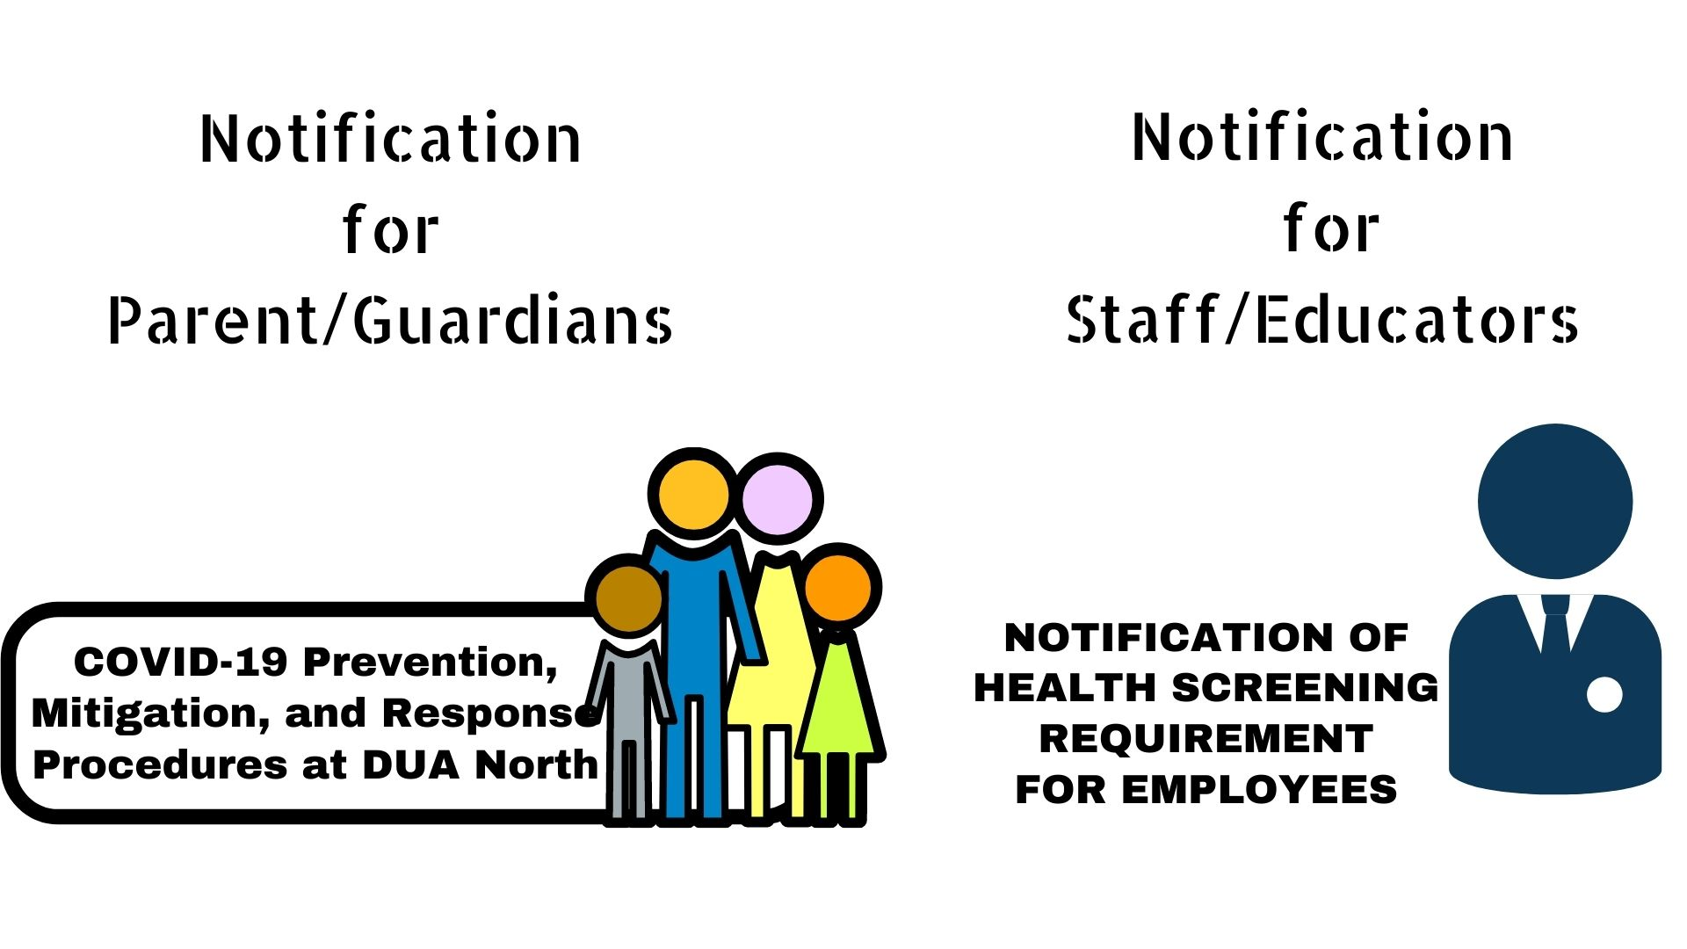

Slide 5
Both letters will contain the following key points in detail
Prevention
Criteria for Return to School
Mitigation
Response

Slide 6
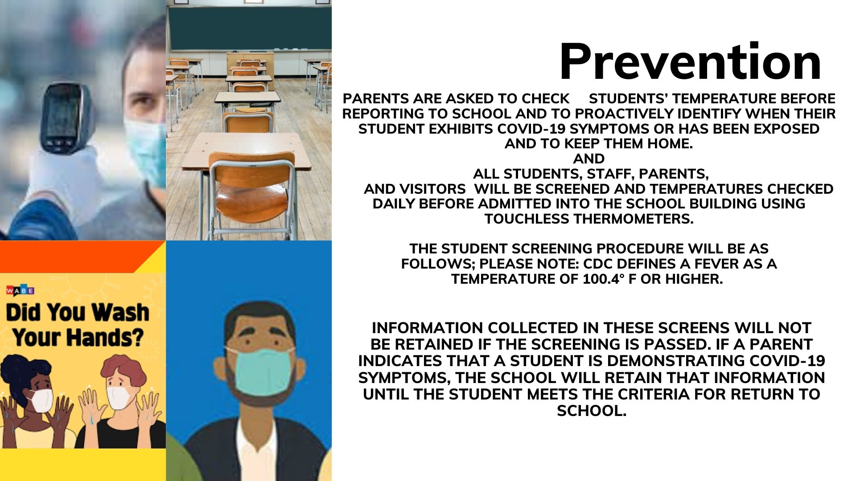

Slide 7
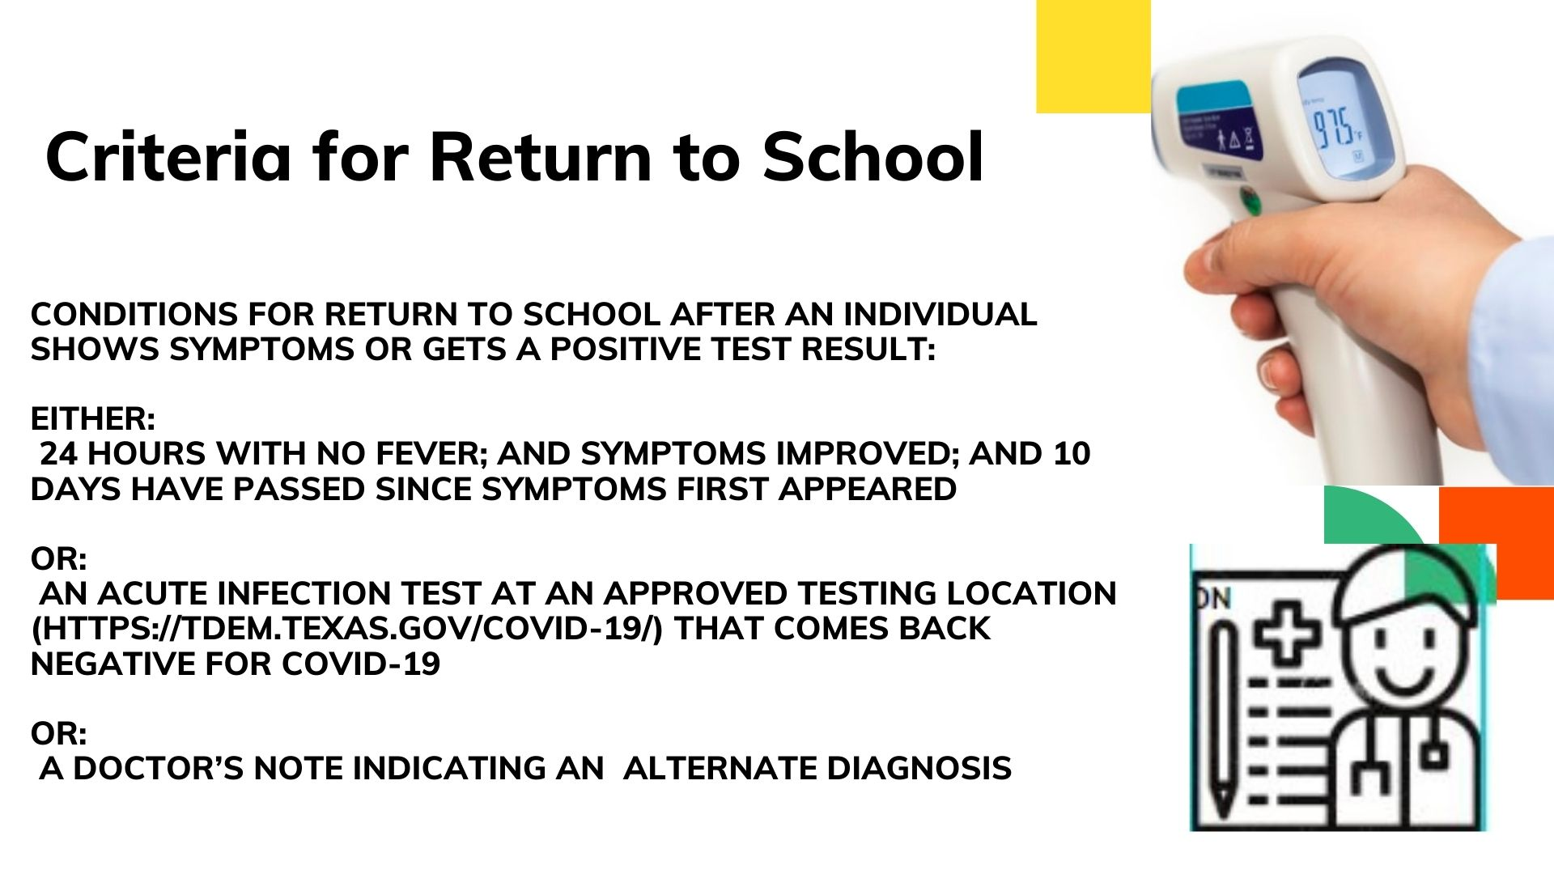

Slide 8
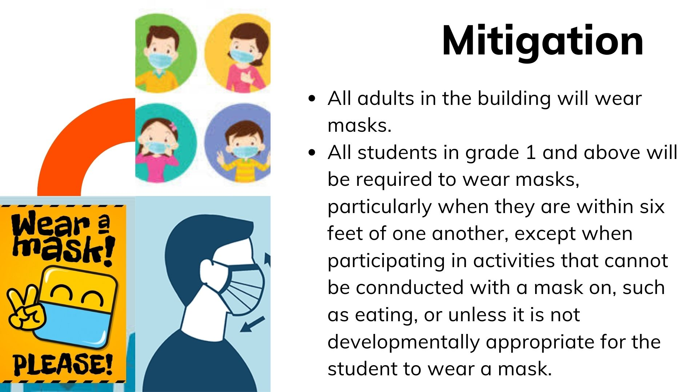

Slide 9
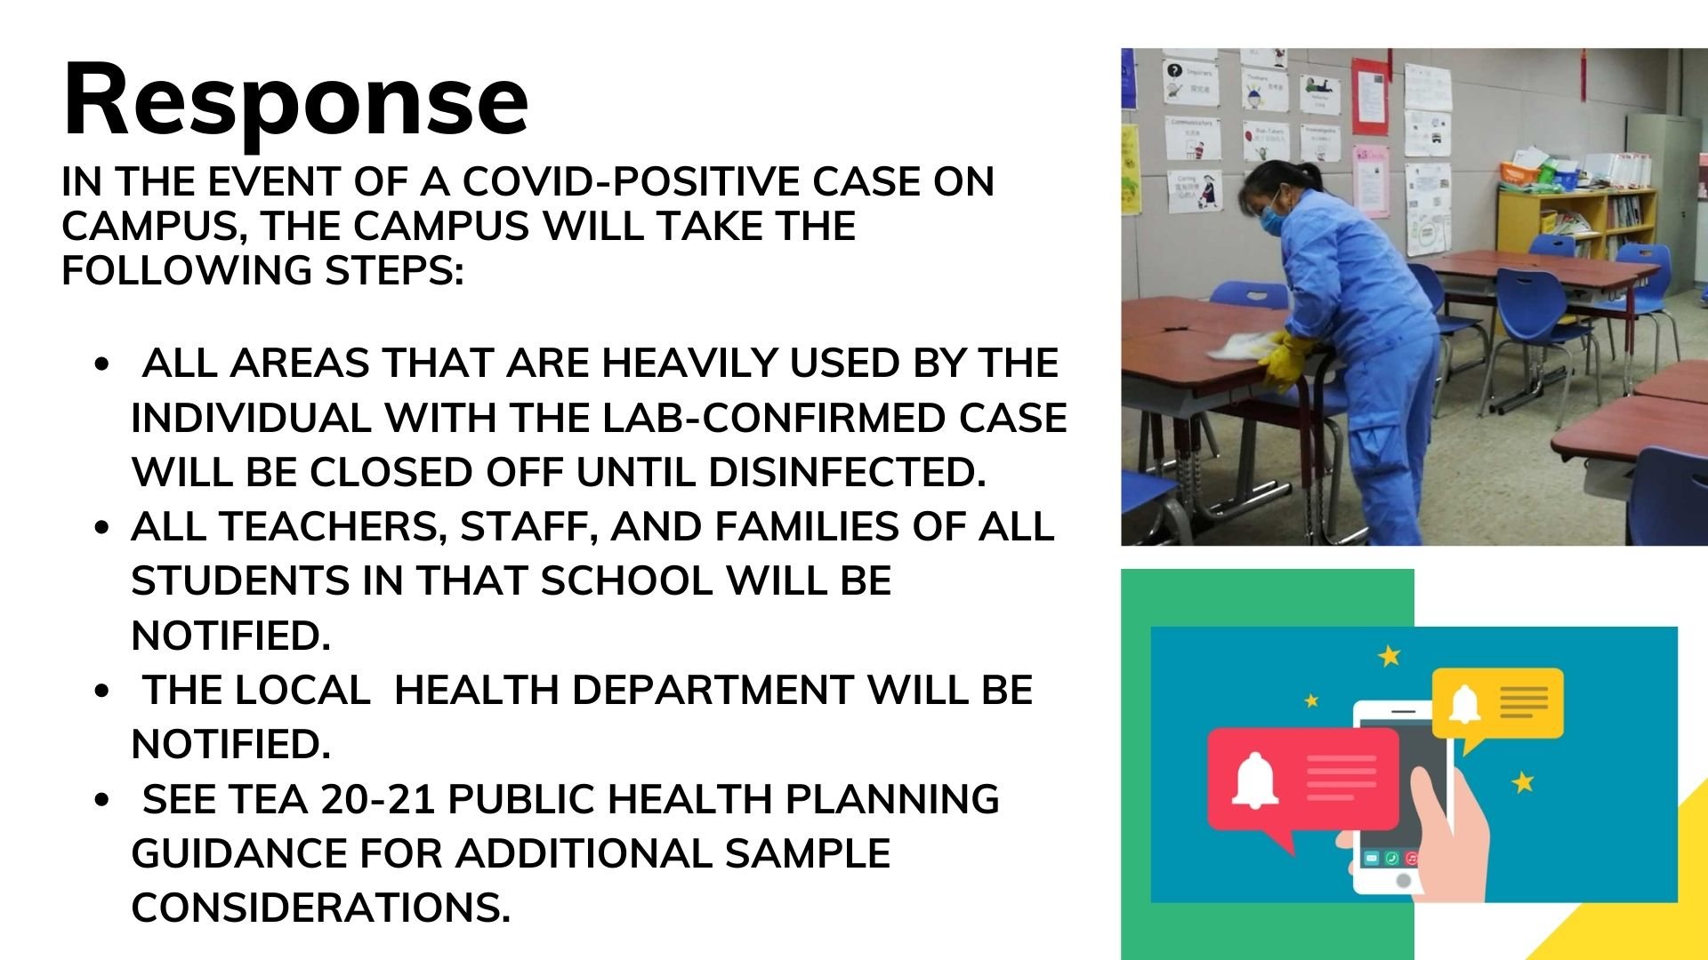

Slide 10
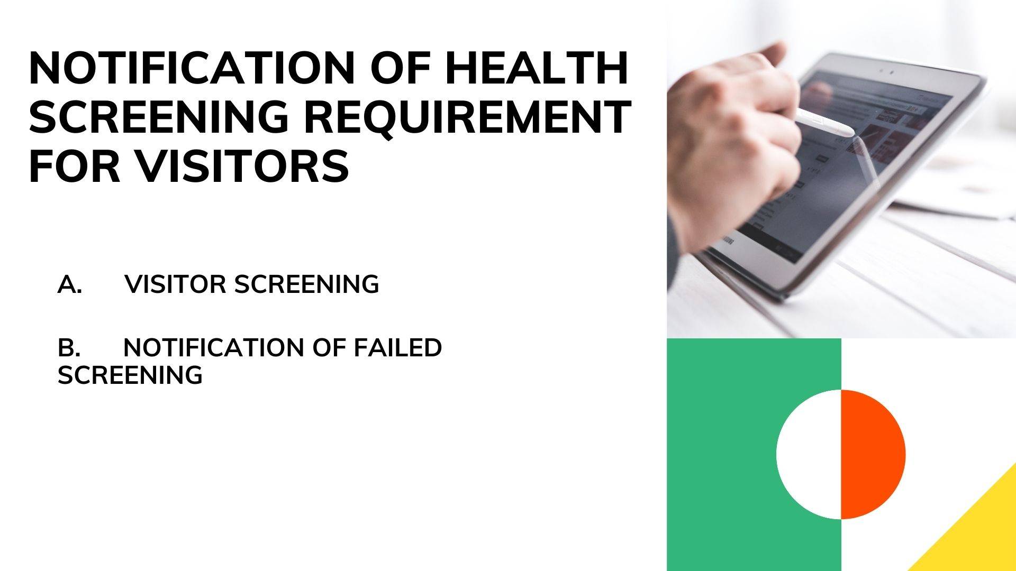

Slide 11
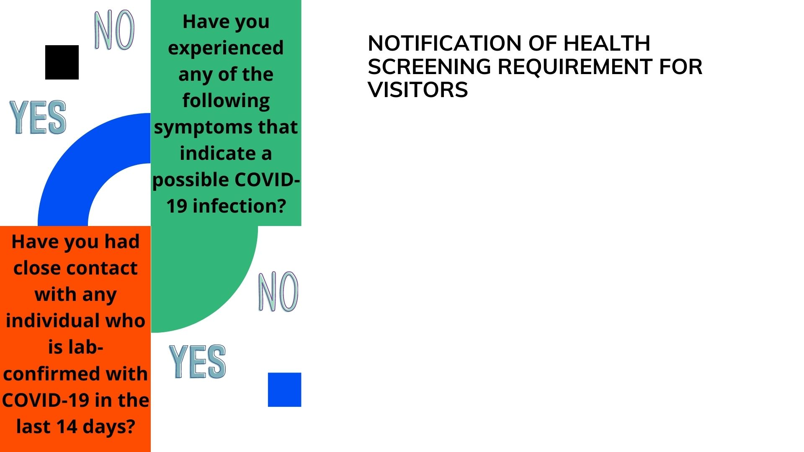
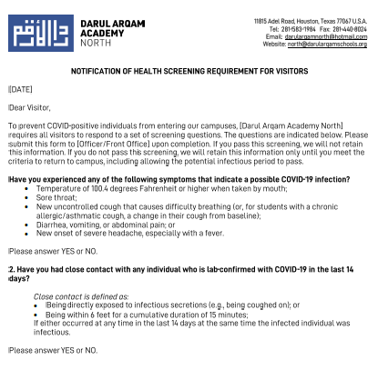

Slide 12

The notification below could be adapted to serve as a popup, flier, email or other method of notification. This information could also be shared with visitors, though it may not be relevant to them in some cases.

Slide 13
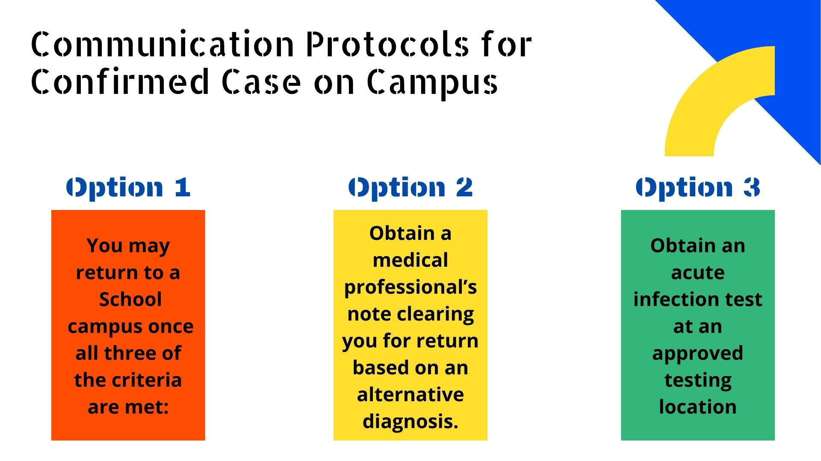

Slide 14

NOTIFICATION OF CONFIRMED COVID-19 CASE ON CAMPUS
Dear Parent/Guardian,
In keeping with IEIT- our parent organization’s practices to respond to COVID-19, we are notifying all student families that a [STUDENT/STAFF MEMBER/VISITOR] who was lab-confirmed to have COVID-19 was present on the campus of [Darul Arqam Academy North] on [LAST DATE OF ATTENDANCE]. Due to privacy requirements, we will not be releasing the name of the individual or details that may identify him or her.
We are working closely with the local health department on this matter. After careful review, we have determined that the COVID-positive person did not come into contact with students, staff, or areas accessed by students or staff. Operations at [Darul Arqam Academy North] will continue as usual, and we will keep you apprised of further updates.
OR
The local health department has begun a case investigation and will contact any individuals determined to be in close contact with the infected individual. All students and staff that came into close contact will be directly notified no later than [Date / Time]. Those that were in close contact will remain off campus for up to 14 days to ensure they do not have the virus, so that there will not be any further spread. We will keep you apprised of further updates.
OR
To give the local health department time to conduct this investigation and notify those who have potentially been infected, as well as clean affected areas, [Darul Arqam Academy North] will be closed until [DATE]. Students and staff will return to campus on [DATE]. We will keep you apprised of further updates.
While we do not have reason to believe that those who were not in close contact with the infected individual have reason to be concerned, we ask that you, as always, watch for symptoms of COVID-19.
Any of the following symptoms indicate a possible COVID-19 infection:
  Temperature of 100.4 degrees Fahrenheit or higher when taken by mouth;
  Sore throat;
  New uncontrolled cough that causes difficulty breathing (or, for students with a chronic allergic/asthmatic cough, a change in their cough from baseline);
  Diarrhea, vomiting, or abdominal pain; or
  New onset of severe headache, especially with a fever.
If you or any member of the [Darul Arqam Academy North] community does begin experiencing any of these symptoms in a way that is not typical, we encourage you to contact your physician. We encourage anyone in the [Darul Arqam Academy North] community who is lab-confirmed to have COVID-19 to please notify our school by contacting the School Principal.

Slide 15


